Slide 1

Kinematics for 5DOF and 6DOF Manipulator
by Sarot SRANG

Slide 2
Review of DH-parameters

Slide 3
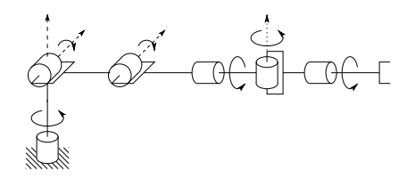

























Denavit-Hartenberg Parameters
$a_{i−1}$: link length (displacement along $x_{i−1}$ from $parent to child$)
$α_{i−1}$: link twist (rotation around $x_{i−1}$ from $z_{i−1}$ to $z_{i}$)
$d_{i}$: link offset (displacement along $z_{i}$ from $x_{i−1}$to $x_{i}$)
$θ_{i}$: joint angle (rotation around $z_{i}$ from $x_{i−1}$to $x_{i}$)
$$z_{1}$$
$$z_{5}$$
Rule 0: there must be a base frame $\left(Ox_{0}y_{0}z_{0}\right)$
Rule 1: Z axis must be on the director of moving vector
Rule 2: $x_{i−1}$ axis lies along common normal between $z_{i−1}$and $z_{i}$
Rule 3: $x_{i}$ intercept $z_{i−1}$ at 0 initial position of revolute joint $i$
$$θ_{2}$$
$$z_{2}$$
$$x_{3,4}$$
$$z_{3}$$
$$θ_{5}$$
$$θ_{3}$$
$$O_{7}$$
$$x_{1,2}$$
$$z_{4}$$
$$θ_{4}$$
$$z_{4′,6}$$
$$l_{1}$$
$$z_{7}$$
$$l_{2}$$
$$d_{6}$$
$$x_{7}$$
$$l_{0}$$
$$θ_{1}$$
$$x_{4′,5,6}$$
$$z_{0}$$
$$x_{0}$$

Slide 4























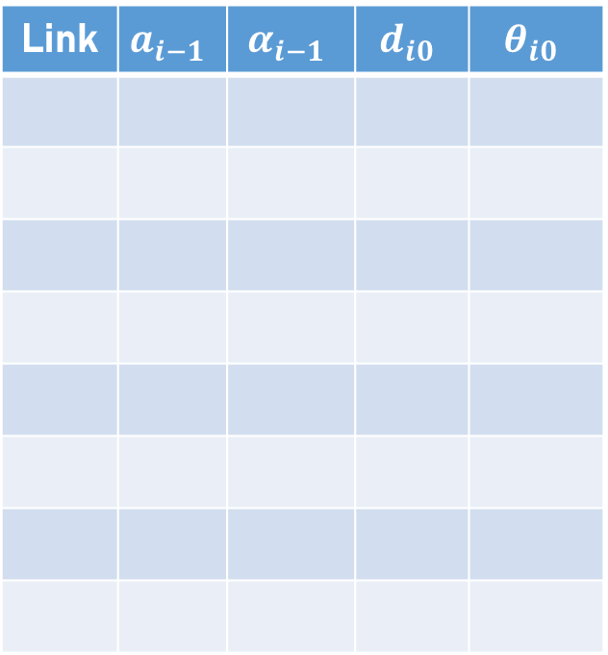





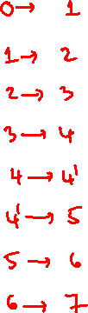


$$z_{1}$$
$$z_{5}$$
$$θ_{2}$$
$$z_{2}$$
$$x_{3,4}$$
$$z_{3}$$
$$θ_{5}$$
$$θ_{3}$$
$$O_{7}$$
$$x_{1,2}$$
$$z_{4}$$
$$θ_{4}$$
$$z_{4′,6}$$
$$l_{1}$$
$$z_{7}$$
$$l_{2}$$
$$d_{6}$$
$$x_{7}$$
$$l_{0}$$
$$θ_{1}$$
$$x_{4′,5,6}$$
Link | $$a_{i−1}$$ | $$α_{i−1}$$ | $$d_{i0}$$ | $$θ_{i0}$$
$$z_{0}$$
$$x_{0}$$

Slide 5
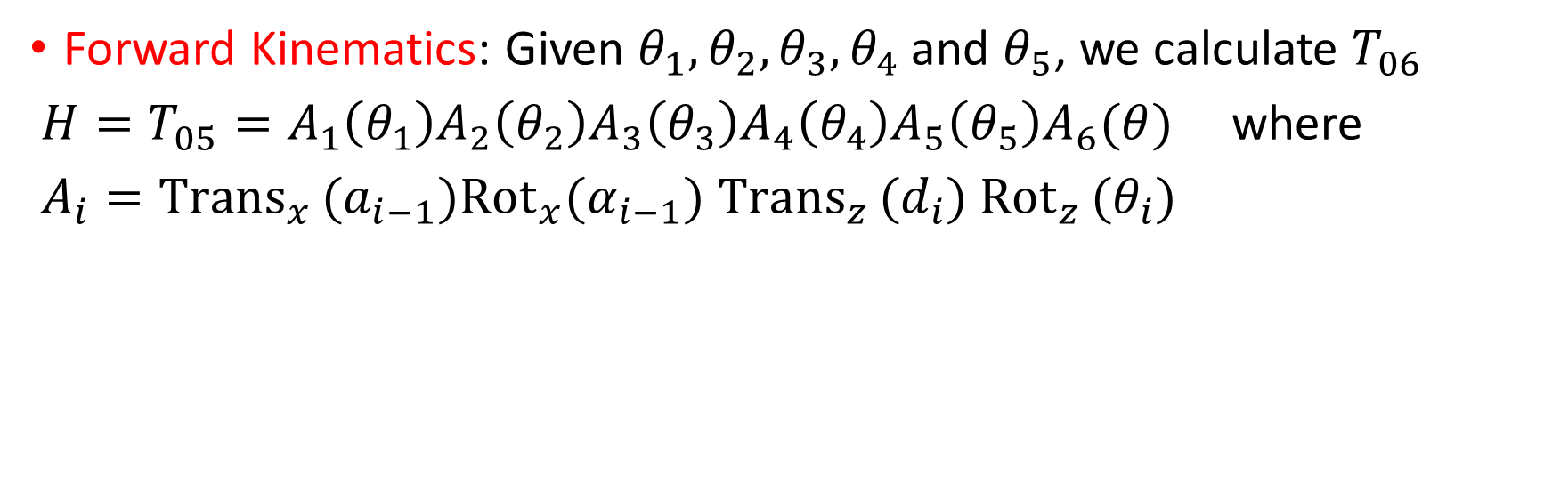
Kinematics of 5DOF Spatial Manipulator
Forward Kinematics: Given $θ_{1}, θ_{2}, θ_{3}, θ_{4}$ and $θ_{5}$, we calculate $T_{06}$
$H=T_{05}=A_{1}\left(θ_{1}\right)A_{2}\left(θ_{2}\right)A_{3}\left(θ_{3}\right)A_{4}\left(θ_{4}\right)A_{5}\left(θ_{5}\right)A_{6}(θ)$ where
$A_{i}={Trans}_{x }(a_{i−1}){Rot}_{x}(α_{i−1})$ $Trans_{z }(d_{i})$ $Rot_{z }(θ_{i})$

Slide 6






$$z_{1}$$
$$z_{5}$$
$$θ_{2}$$
$$z_{2}$$
$$x_{3,4}$$
$$z_{3}$$
$$θ_{5}$$
$$θ_{3}$$
$$O_{6}$$
$$x_{1,2}$$
$$z_{4}$$
$$z_{4′}$$
$$z_{6}$$
$$θ_{4}$$
$$l_{1}$$
$$l_{2}$$
$$x_{6}$$
$$d$$
$$l_{0}$$
$$θ_{1}$$
$$x_{4′,5,6}$$
Link | $$a_{i−1}$$ | $$α_{i−1}$$ | $$d_{i0}$$ | $$θ_{i0}$$
$$z_{0}$$
$$x_{0}$$

Slide 7
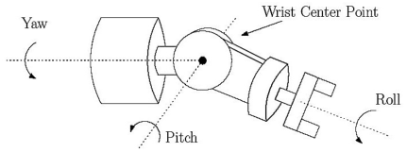
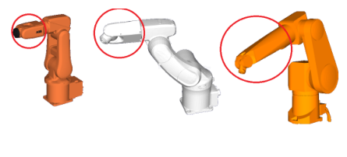

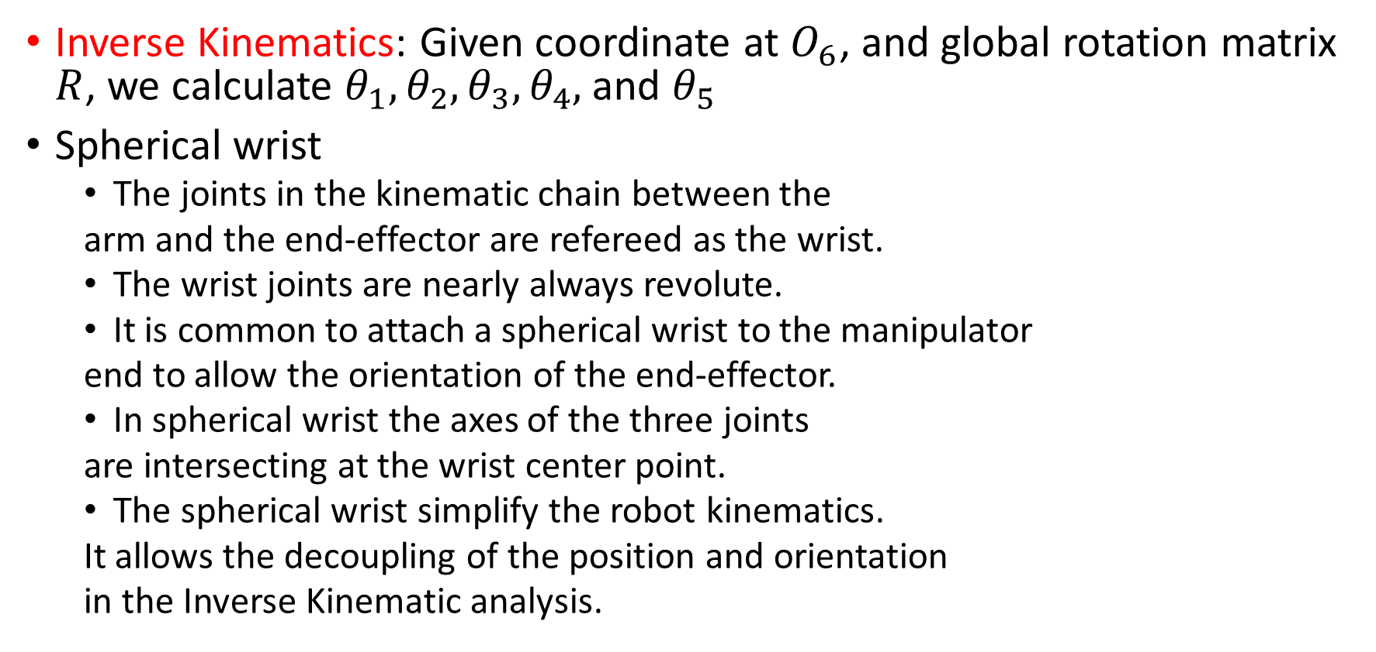
Kinematics of 5DOF Spatial Manipulator
Inverse Kinematics: Given coordinate at $O_{6}$, and global rotation matrix $R$, we calculate $θ_{1}, θ_{2}, θ_{3}, θ_{4},$ and $θ_{5}$
Spherical wrist
The joints in the kinematic chain between the
arm and the end-effector are refereed as the wrist.
The wrist joints are nearly always revolute.
It is common to attach a spherical wrist to the manipulator
end to allow the orientation of the end-effector.
In spherical wrist the axes of the three joints
are intersecting at the wrist center point.
The spherical wrist simplify the robot kinematics.
It allows the decoupling of the position and orientation
in the Inverse Kinematic analysis.

Slide 8
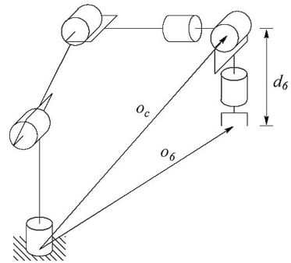
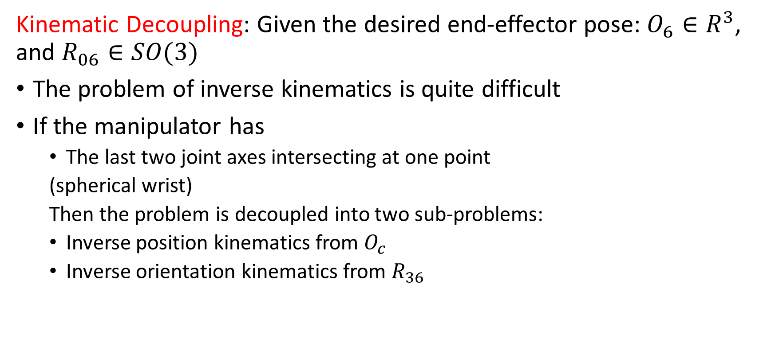
Kinematics of 5DOF Spatial Manipulator
Kinematic Decoupling: Given the desired end-effector pose: $O_{6}∈R^{3}$, and $R_{06}∈SO(3)$
The problem of inverse kinematics is quite difficult
If the manipulator has
The last two joint axes intersecting at one point
(spherical wrist)
Then the problem is decoupled into two sub-problems:
Inverse position kinematics from $O_{c}$
Inverse orientation kinematics from $R_{36}$

Slide 9
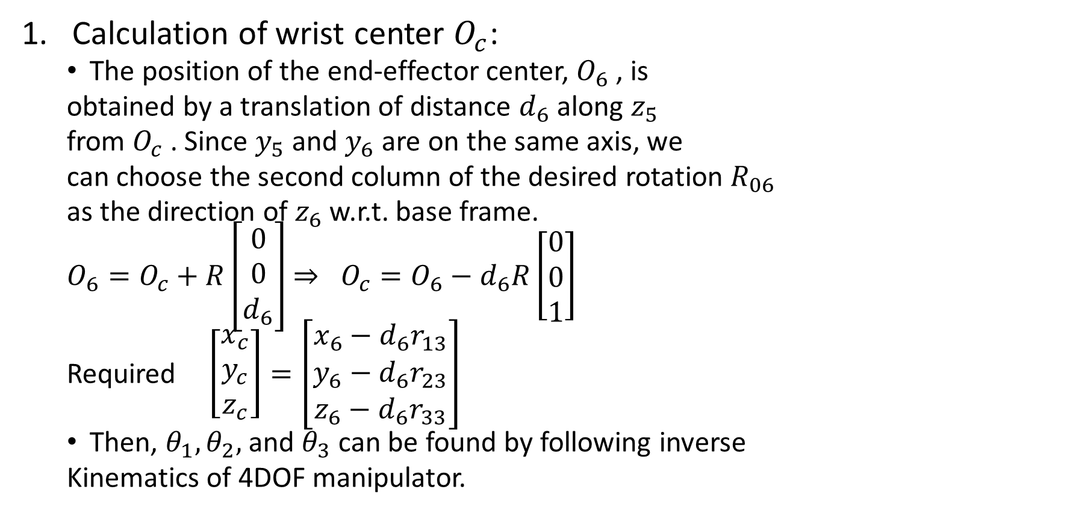
Kinematics of 5DOF Spatial Manipulator
Calculation of wrist center $O_{c}$:
The position of the end-effector center, $O_{6}$ , is
obtained by a translation of distance $d_{6}$ along $z_{5}$
from $O_{c}$ . Since $y_{5}$ and $y_{6}$ are on the same axis, we
can choose the second column of the desired rotation $R_{06}$
as the direction of $z_{6}$ w.r.t. base frame.
$O_{6}=O_{c}+R\left[\begin{aligned}0 \\ 0 \\ d_{6}\end{aligned}\right]$ $⇒ O_{c}=O_{6}−d_{6}R\left[\begin{aligned}0 \\ 0 \\ 1\end{aligned}\right]$
Required $\left[\begin{aligned}x_{c} \\ y_{c} \\ z_{c}\end{aligned}\right]=\left[\begin{aligned}x_{6}−d_{6}r_{13} \\ y_{6}−d_{6}r_{23} \\ z_{6}−d_{6}r_{33}\end{aligned}\right]$
Then, $θ_{1},θ_{2},$ and $θ_{3}$ can be found by following inverse
Kinematics of 4DOF manipulator.

Slide 10
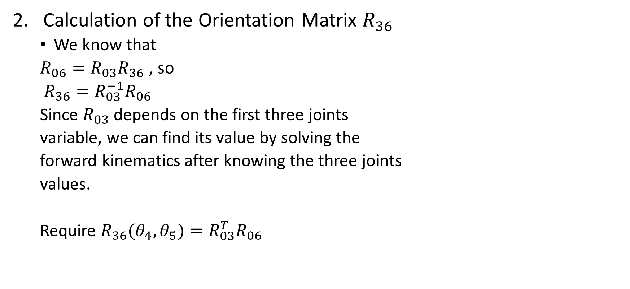
Kinematics of 5DOF Spatial Manipulator
Calculation of the Orientation Matrix $R_{36}$
We know that
$R_{06}=R_{03}R_{36}$ , so
$R_{36}=R_{03}^{−1}R_{06}$
Since $R_{03}$ depends on the first three joints
variable, we can find its value by solving the
forward kinematics after knowing the three joints
values.
Require $R_{36}(θ_{4},θ_{5})=R_{03}^{T}R_{06}$

Slide 11

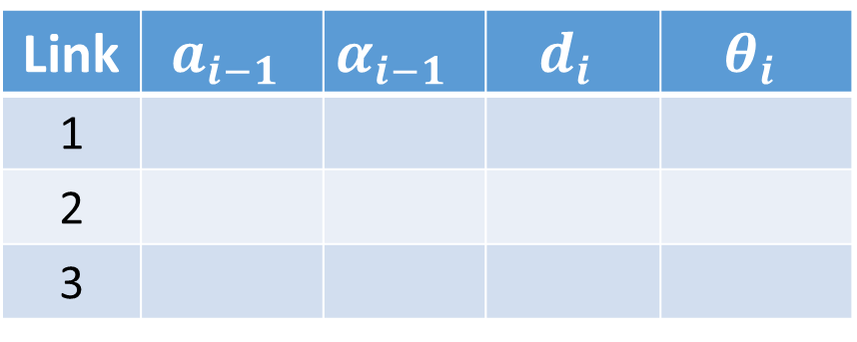
Kinematics of 5DOF Spatial Manipulator
$R_{03}=$Rotation$(T_{03})$ from DH parameters
Homework (verify the parameters)
Link | $$a_{i−1}$$ | $$α_{i−1}$$ | $$d_{i}$$ | $$θ_{i}$$
1
2
3

Slide 12
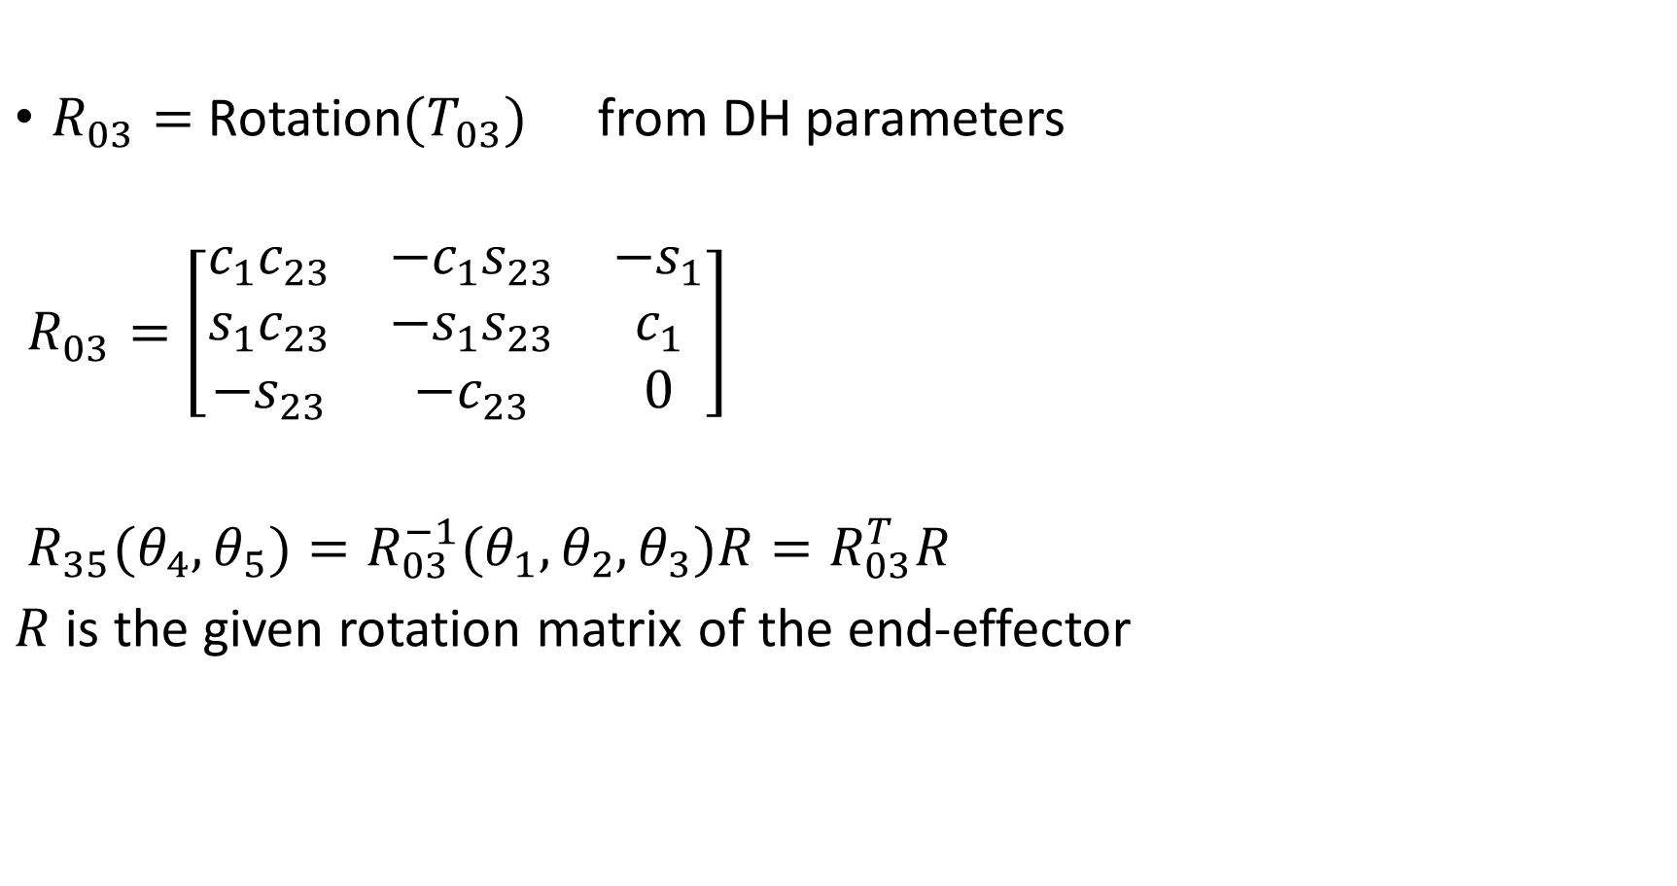
Kinematics of 5DOF Spatial Manipulator
$R_{03}=$ Rotation$(T_{03})$ from DH parameters
$R_{03}=$ $\left[\begin{matrix}c_{1}c_{23} & −c_{1}s_{23} & {−s}_{1} \\ s_{1}c_{23} & −s_{1}s_{23} & c_{1} \\ {−s}_{23} & {−c}_{23} & 0\end{matrix}\right]$
$R_{35}(θ_{4},θ_{5})=R_{03}^{−1}(θ_{1},θ_{2},θ_{3})R=R_{03}^{T}R$
$R$ is the given rotation matrix of the end-effector

Slide 13
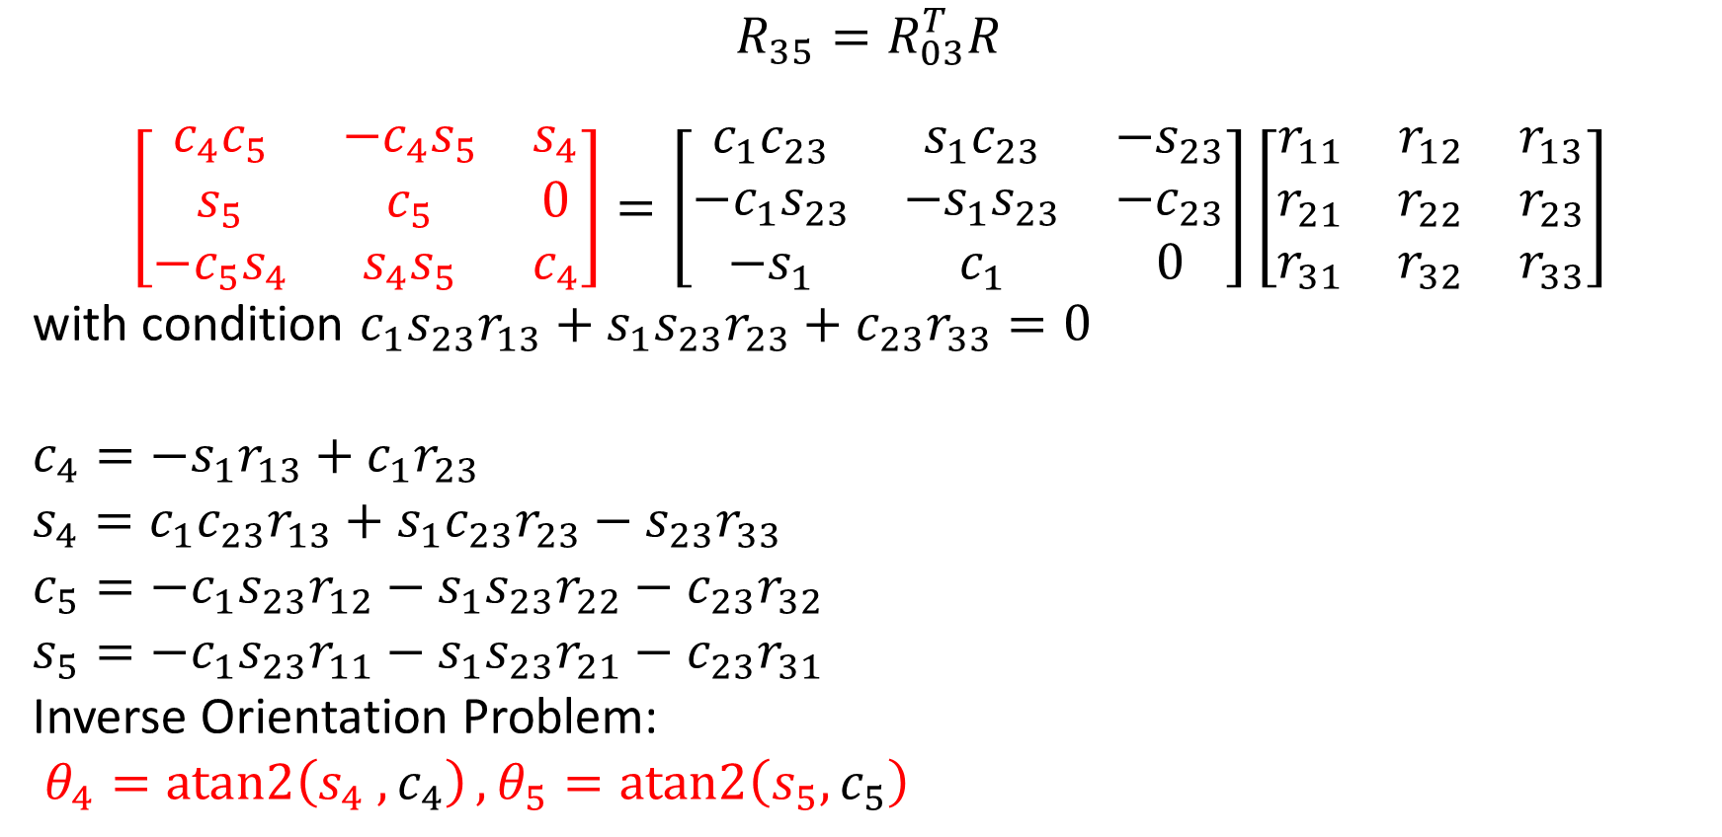
Kinematics of 5DOF Spatial Manipulator
$$R_{35}=R_{03}^{T}R$$
$$\left[\begin{matrix}c_{4}c_{5} & −c_{4}s_{5} & s_{4} \\ s_{5} & c_{5} & 0 \\ −c_{5}s_{4} & s_{4}s_{5} & c_{4}\end{matrix}\right]=\left[\begin{matrix}c_{1}c_{23} & s_{1}c_{23} & {−s}_{23} \\ −c_{1}s_{23} & −s_{1}s_{23} & {−c}_{23} \\ −s_{1} & c_{1} & 0\end{matrix}\right]\left[\begin{matrix}r_{11} & r_{12} & r_{13} \\ r_{21} & r_{22} & r_{23} \\ r_{31} & r_{32} & r_{33}\end{matrix}\right]$$
with condition $c_{1}s_{23}r_{13}+s_{1}s_{23}r_{23}+c_{23}r_{33}=0$
$c_{4}={−s}_{1}r_{13}+c_{1}r_{23}$
$s_{4}=c_{1}c_{23}r_{13}+s_{1}c_{23}r_{23}−s_{23}r_{33}$
$c_{5}=−c_{1}s_{23}r_{12}−s_{1}s_{23}r_{22}−c_{23}r_{32}$
$s_{5}=−c_{1}s_{23}r_{11}−s_{1}s_{23}r_{21}−c_{23}r_{31}$
Inverse Orientation Problem:
$θ_{4}=atan2\left(s_{4} ,c_{4}\right), θ_{5}=atan2\left(s_{5},c_{5}\right)$

Slide 14

Kinematics of 5DOF Spatial Manipulator
If $s_{5}>0$
$θ_{4}=atan2{(−}c_{1}s_{23}r_{13}−s_{1}s_{23}r_{23}+c_{23}r_{33}, c_{1}c_{23}r_{13}+s_{1}c_{23}r_{23}+s_{23}r_{33})$
If $s_{5}<0$
$θ_{4}=atan2{(}c_{1}s_{23}r_{13}+s_{1}s_{23}r_{23}−c_{23}r_{33}, −c_{1}c_{23}r_{13}−s_{1}c_{23}r_{23}−s_{23}r_{33})$

Slide 15

Kinematics of 6DOF Spatial Manipulator
Forward Kinematics: Given $θ_{1}, θ_{2}, θ_{3}, θ_{4}, θ_{5}$ and $θ_{6}$, we calculate $T_{06}$
$T_{06}=A_{1}\left(θ_{1}\right)A_{2}\left(θ_{2}\right)A_{3}\left(θ_{3}\right)A_{4}\left(θ_{4}\right)A_{5}\left(θ_{5}\right)A_{6}(θ_{6})$ where
$A_{i}={Trans}_{x }(a_{i}){Rot}_{x}(α_{i})$ $Trans_{z }(d_{i})$ $Rot_{z }(θ_{i})$

Slide 16

$$z_{1}$$
$$z_{5}$$
$$θ_{2}$$
$$z_{2}$$
$$x_{3,4}$$
$$z_{3}$$
$$θ_{5}$$
$$θ_{3}$$
$$O_{7}$$
$$x_{1,2}$$
$$z_{4}$$
$$θ_{4}$$
$$z_{4′,6}$$
$$l_{1}$$
$$z_{7}$$
$$l_{2}$$
$$d_{6}$$
$$x_{7}$$
$$l_{0}$$
$$θ_{1}$$
$$x_{4′,5,6}$$
Link | $$a_{i−1}$$ | $$α_{i−1}$$ | $$d_{i0}$$ | $$θ_{i0}$$
$$z_{0}$$
$$x_{0}$$

Slide 17

Kinematics of 6DOF Spatial Manipulator
Inverse Kinematics: Given coordinate at $O_{6}$, and global rotation matrix $R$, we calculate $θ_{1}, θ_{2}, θ_{3}, θ_{4},$ $θ_{5}$ and $θ_{6}$
Spherical wrist
The joints in the kinematic chain between the
arm and the end-effector are refereed as the wrist.
The wrist joints are nearly always revolute.
It is common to attach a spherical wrist to the manipulator
end to allow the orientation of the end-effector.
In spherical wrist the axes of the three joints
are intersecting at the wrist center point.
The spherical wrist simplify the robot kinematics.
It allows the decoupling of the position and orientation
in the Inverse Kinematic analysis.

Slide 18
Kinematics of 6DOF Spatial Manipulator
Kinematic Decoupling: Given the desired end-effector pose: $O_{6}∈R^{3}$, and $R_{06}∈SO(3)$
The problem of inverse kinematics is quite difficult
If the manipulator has
The last two joint axes intersecting at one point
(spherical wrist)
Then the problem is decoupled into two sub-problems:
Inverse position kinematics from $O_{c}$
Inverse orientation kinematics from $R_{36}$

Slide 19
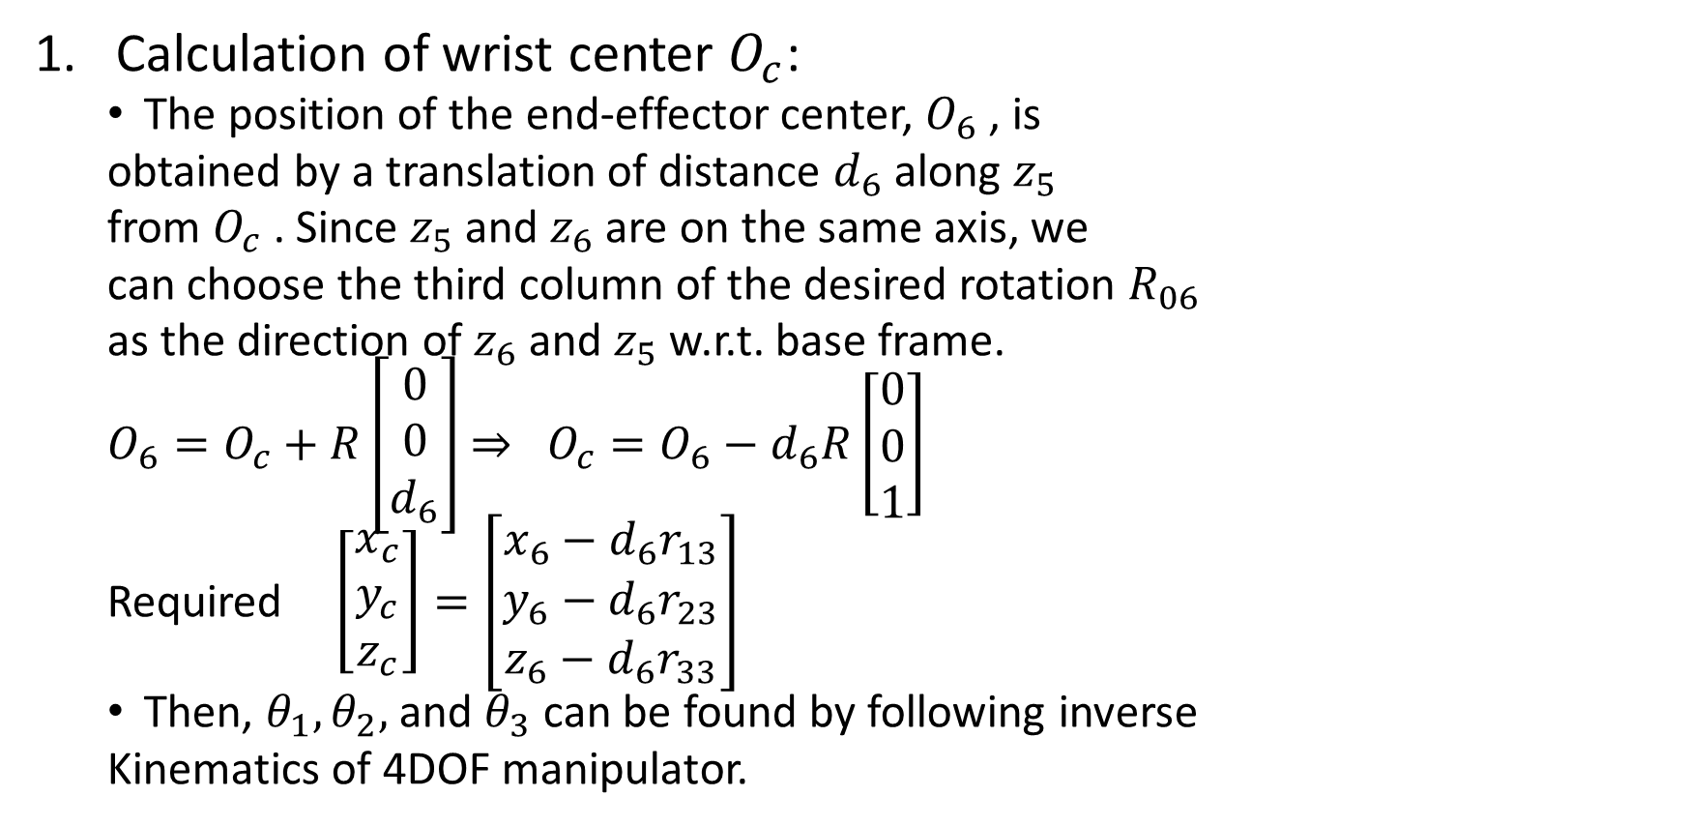
Kinematics of 6DOF Spatial Manipulator
Calculation of wrist center $O_{c}$:
The position of the end-effector center, $O_{6}$ , is
obtained by a translation of distance $d_{6}$ along $z_{5}$
from $O_{c}$ . Since $z_{5}$ and $z_{6}$ are on the same axis, we
can choose the third column of the desired rotation $R_{06}$
as the direction of $z_{6}$ and $z_{5}$ w.r.t. base frame.
$O_{6}=O_{c}+R\left[\begin{aligned}0 \\ 0 \\ d_{6}\end{aligned}\right]$ $⇒ O_{c}=O_{6}−d_{6}R\left[\begin{aligned}0 \\ 0 \\ 1\end{aligned}\right]$
Required $\left[\begin{aligned}x_{c} \\ y_{c} \\ z_{c}\end{aligned}\right]=\left[\begin{aligned}x_{6}−d_{6}r_{13} \\ y_{6}−d_{6}r_{23} \\ z_{6}−d_{6}r_{33}\end{aligned}\right]$
Then, $θ_{1},θ_{2},$ and $θ_{3}$ can be found by following inverse
Kinematics of 4DOF manipulator.

Slide 20
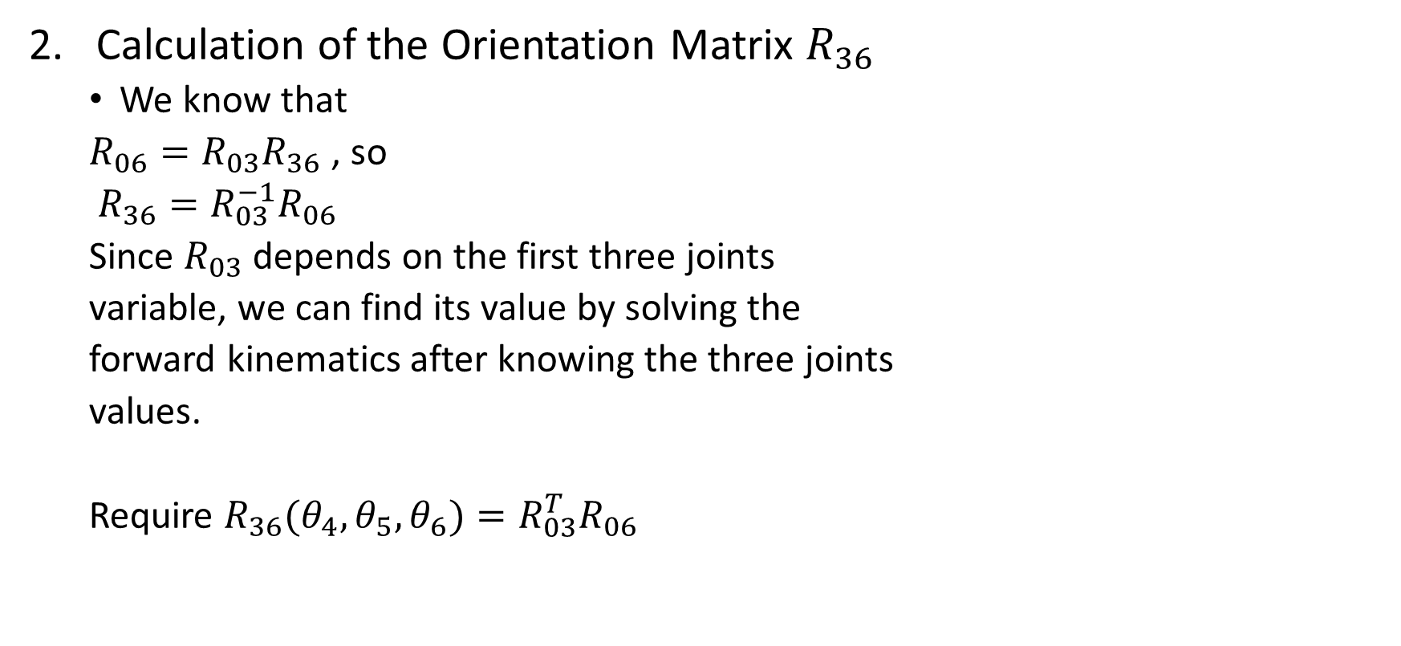
Kinematics of 6DOF Spatial Manipulator
Calculation of the Orientation Matrix $R_{36}$
We know that
$R_{06}=R_{03}R_{36}$ , so
$R_{36}=R_{03}^{−1}R_{06}$
Since $R_{03}$ depends on the first three joints
variable, we can find its value by solving the
forward kinematics after knowing the three joints
values.
Require $R_{36}(θ_{4},θ_{5},θ_{6})=R_{03}^{T}R_{06}$

Slide 21
Kinematics of 6DOF Spatial Manipulator
$R_{03}=$Rotation$(T_{03})$ from DH parameters
Homework (verify the parameters)
Link | $$a_{i−1}$$ | $$α_{i−1}$$ | $$d_{i}$$ | $$θ_{i}$$
1
2
3

Slide 22
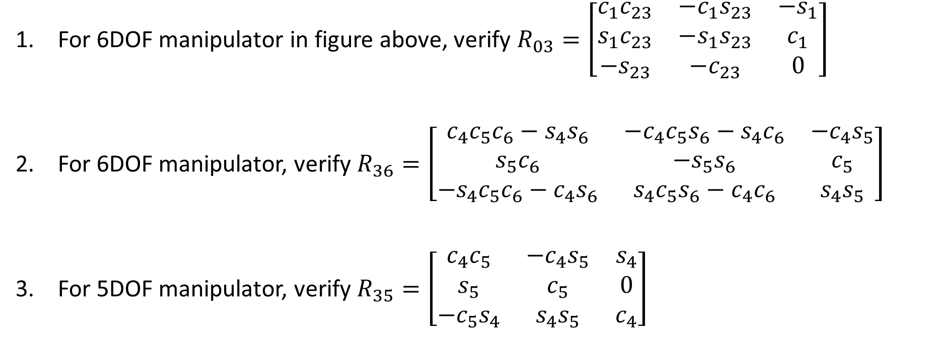
Assignment 3
For 6DOF manipulator in figure above, verify $R_{03}=\left[\begin{matrix}c_{1}c_{23} & −c_{1}s_{23} & {−s}_{1} \\ s_{1}c_{23} & −s_{1}s_{23} & c_{1} \\ {−s}_{23} & {−c}_{23} & 0\end{matrix}\right]$
For 6DOF manipulator, verify $R_{36}=\left[\begin{matrix}c_{4}c_{5}c_{6}−s_{4}s_{6} & −c_{4}c_{5}s_{6}−s_{4}c_{6} & −c_{4}s_{5} \\ s_{5}c_{6} & −s_{5}s_{6} & c_{5} \\ −s_{4}c_{5}c_{6}−c_{4}s_{6} & s_{4}c_{5}s_{6}−c_{4}c_{6} & s_{4}s_{5}\end{matrix}\right]$
For 5DOF manipulator, verify $R_{35}=\left[\begin{matrix}c_{4}c_{5} & −c_{4}s_{5} & s_{4} \\ s_{5} & c_{5} & 0 \\ −c_{5}s_{4} & s_{4}s_{5} & c_{4}\end{matrix}\right]$

Slide 23

Kinematics of 6DOF Spatial Manipulator
$R_{03}=$ Rotation$(T_{03})$ from DH parameters
$R_{03}=$ $\left[\begin{matrix}c_{1}c_{23} & −c_{1}s_{23} & {−s}_{1} \\ s_{1}c_{23} & −s_{1}s_{23} & c_{1} \\ {−s}_{23} & {−c}_{23} & 0\end{matrix}\right]$
$R_{36}(θ_{4},θ_{5},θ_{6})=R_{03}^{−1}R=R_{03}^{T}R$
$R$ is the given rotation matrix of the end-effector

Slide 24


Kinematics of 6DOF Spatial Manipulator
$$R_{36}=R_{03}^{T}R_{06}$$
$$\left[\begin{matrix}c_{4}c_{5}c_{6}−s_{4}s_{6} & −c_{4}c_{5}s_{6}−s_{4}c_{6} & −c_{4}s_{5} \\ s_{5}c_{6} & −s_{5}s_{6} & c_{5} \\ −s_{4}c_{5}c_{6}−c_{4}s_{6} & s_{4}c_{5}s_{6}−c_{4}c_{6} & s_{4}s_{5}\end{matrix}\right]=\left[\begin{matrix}c_{1}c_{23} & s_{1}c_{23} & {−s}_{23} \\ −c_{1}s_{23} & −s_{1}s_{23} & {−c}_{23} \\ −s_{1} & c_{1} & 0\end{matrix}\right]\left[\begin{matrix}r_{11} & r_{12} & r_{13} \\ r_{21} & r_{22} & r_{23} \\ r_{31} & r_{32} & r_{33}\end{matrix}\right]$$
$c_{5}=R_{36}(2,3)$
$θ_{5}=atan2\left(±\sqrt{1−c_{5}^{2}}, c_{5}\right)$
$s_{4}s_{5}=R_{36}(3,3)$
${c_{4}s}_{5}=−R_{36}(1,3)$
Inverse Orientation Problem:
If $s_{5}>0$
$θ_{4}=atan2\left(s_{4}s_{5},c_{4}s_{5}\right)$
Else
$θ_{4}=atan2\left(−s_{4}s_{5}, −c_{4}s_{5}\right)$
Follow the same process to find $θ_{6}$

Slide 25

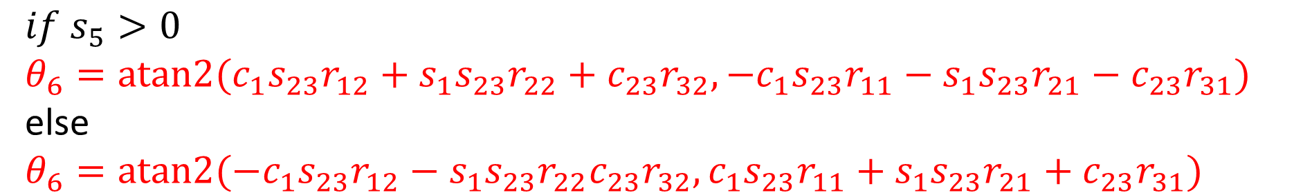
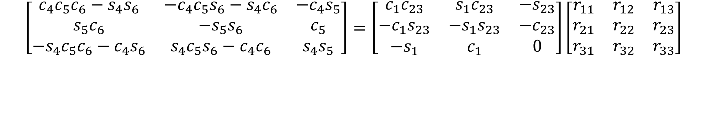
Find $θ_{6}$
$$\left[\begin{matrix}c_{4}c_{5}c_{6}−s_{4}s_{6} & −c_{4}c_{5}s_{6}−s_{4}c_{6} & −c_{4}s_{5} \\ s_{5}c_{6} & −s_{5}s_{6} & c_{5} \\ −s_{4}c_{5}c_{6}−c_{4}s_{6} & s_{4}c_{5}s_{6}−c_{4}c_{6} & s_{4}s_{5}\end{matrix}\right]=\left[\begin{matrix}c_{1}c_{23} & s_{1}c_{23} & {−s}_{23} \\ −c_{1}s_{23} & −s_{1}s_{23} & {−c}_{23} \\ −s_{1} & c_{1} & 0\end{matrix}\right]\left[\begin{matrix}r_{11} & r_{12} & r_{13} \\ r_{21} & r_{22} & r_{23} \\ r_{31} & r_{32} & r_{33}\end{matrix}\right]$$
$s_{5}c_{6}=−c_{1}s_{23}r_{11}−s_{1}s_{23}r_{21}−c_{23}r_{31}$
$s_{5}s_{6}=c_{1}s_{23}r_{12}+s_{1}s_{23}r_{22}+c_{23}r_{32}$
$if s_{5}>0$
$θ_{6}=atan2{(c_{1}s_{23}r_{12}+s_{1}s_{23}r_{22}+c_{23}r_{32},−c_{1}s_{23}r_{11}−s_{1}s_{23}r_{21}−c_{23}r_{31})}$
else
$θ_{6}=atan2{(−c_{1}s_{23}r_{12}−s_{1}s_{23}r_{22}c_{23}r_{32},c_{1}s_{23}r_{11}+s_{1}s_{23}r_{21}+c_{23}r_{31})}$

Slide 26
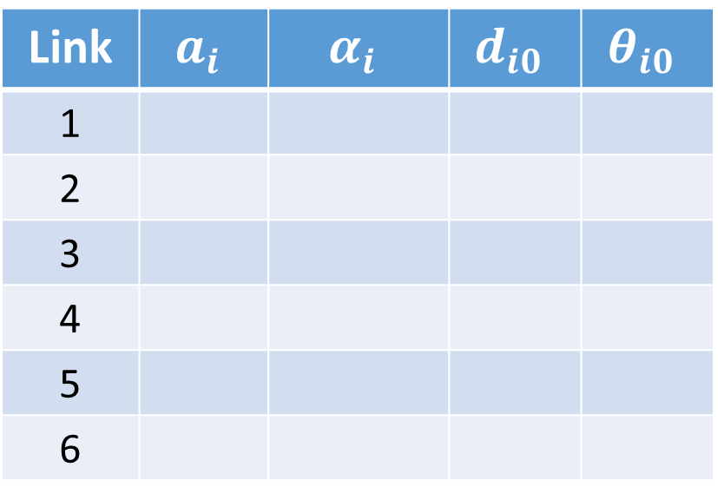
Assignment 4
Link | $$a_{i}$$ | $$α_{i}$$ | $$d_{i0}$$ | $$θ_{i0}$$
1
2
3
4
5
6
Define the coordinate frames using MATLAB!

